Slide 1
Title Page
(Add Ames, Iowa background photo)

Slide 2
Introduction
Who we are: a consultant for real estate firm
Real Estate firm clients would be people moving from a larger city to a smaller town like Ames to save on housing costs, but work remotely
Client main concerns:
Proximity to particular services specified by the client
Housing price based on amenities
Real Estate Firm concerns:
How did the housing market change due to the pandemic (i.e. 2019 vs 2021 data)
Proximity to which services impact sale price the most to better advise their clients
Wants to understand where to position advertising

Slide 3
Housing Data Slide
Describe specific fields
Feature Engineered fields
Regular standard features selected by greedy algorithm
Discuss where the housing data came from (Ames City Assessor)
Show distribution of important fields for predicting SalePrice
Show descriptive models (what fields affect and correlate with SalePrice)
Discuss which years were chosen and why (2019, 2021)
Visualizations:
Show visualizations for trends in the housing prices and the number of homes sold per month
Show all Area/SF fields and engineered fields in one bar chart
Show frequency table of “Has_” fields
Show Correlations using heatmap to show which fields are more correlated to SalePrice
Data Visualization of the important fields from Real Estate data for 2019, 2021

Slide 4
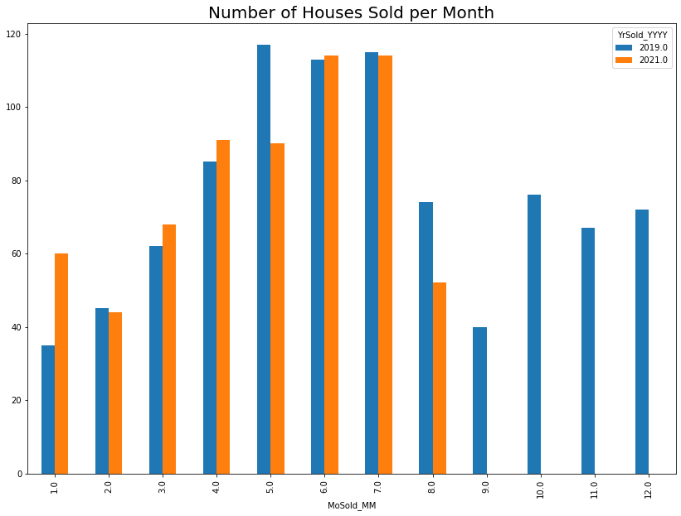
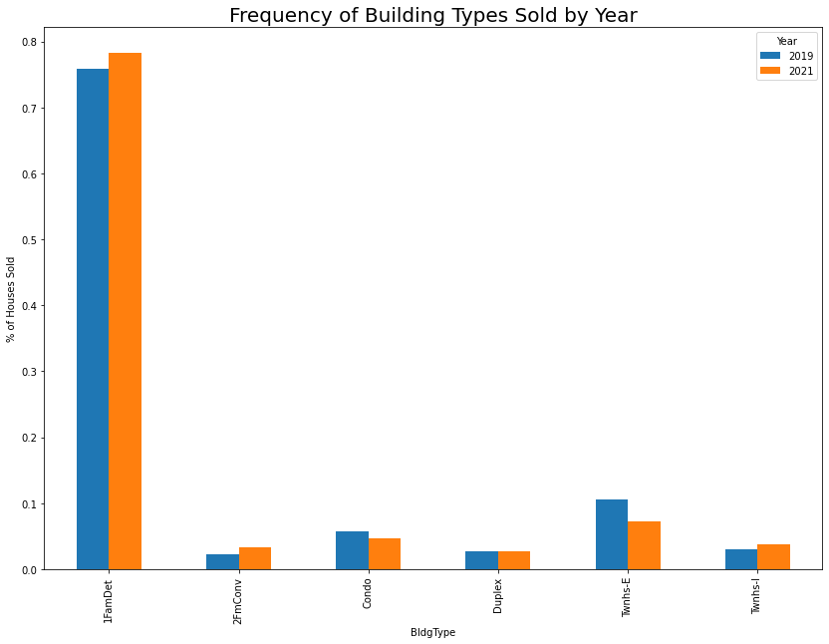
Housing Data Slide 2

Slide 5
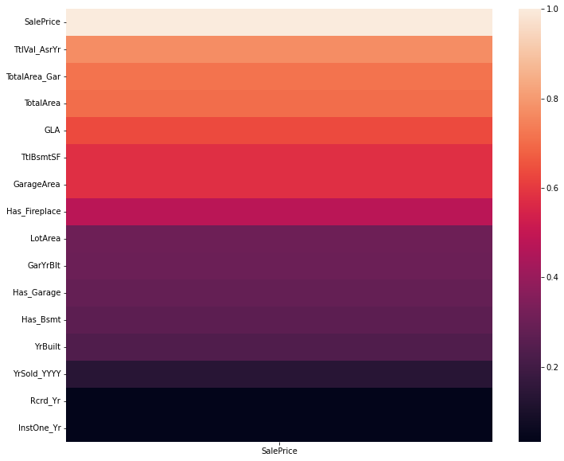
Housing Data Slide 3
Feature Correlations with SalePrice and Feature Importances from descriptive RFR model for predicting SalePrice
Name | Importance
Assessor Value | 0.79453223
Year Sold | 0.02416647
Drive Time to Nearest Service | 0.02173991
Year Built | 0.01843789
Garage Year Built | 0.0157063
Mean Drive Time to All Services | 0.01461887
Drive Time to Town Center | 0.01350294
Total House Area (with Garage and Basement) | 0.01203543
Mean Drive Time to Closest 5 Services | 0.01191871
TotalArea | 0.01036392

Slide 6
Services Slide (df_Essentials)
Discuss criteria for selecting a business within each service
Give a list and description of services that we considered
Provide map of businesses by services (color coded with their distribution across the city)
Visualizations:
Map of the businesses selected

Slide 7
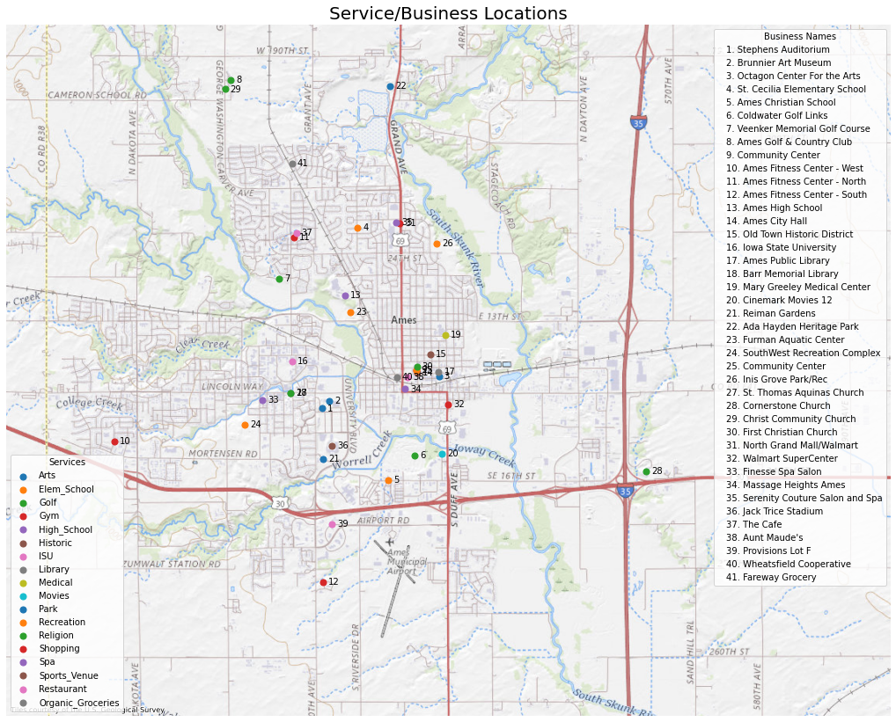

Slide 8
LatLong and Drive Time section
Describe source and method for calculating LatLongs, drive time and min point to point distances (OSMR, Nominatim, GeoApify, reverselookup etc)
Talk about why we used drive time as opposed to driving distance
Using preliminary descriptive linear models, time presented a higher R^2 than driving distance. This is probably because drive time takes road conditions into account (number of traffic lights, stop signs, traffic conditions, street directions etc)
Discuss methodology for latlong and drive time lookup
First found Latlongs. The Latlongs found were verified using reverselookup. Manually corrected any discrepancies. Then looked up driving times and driving distances through an API
List of resource used: OSMR, Nominatim, GeoApify and Google Maps.

Slide 9
Feature Engineering Section
What fields we created and their significance (“Has_” Booleans, TotalArea and TotalArea with Garage, combined Ext1/2 field into dummy set of cols, dummies for HouseStyle and GarageType)
Talk about reengineered times and distances. Minimum distances based on geography.
Closest_5 field, convenience, centrality, num_biz within 180s/480

Slide 10
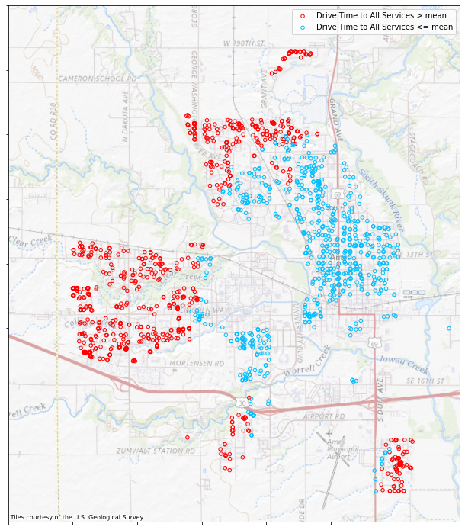
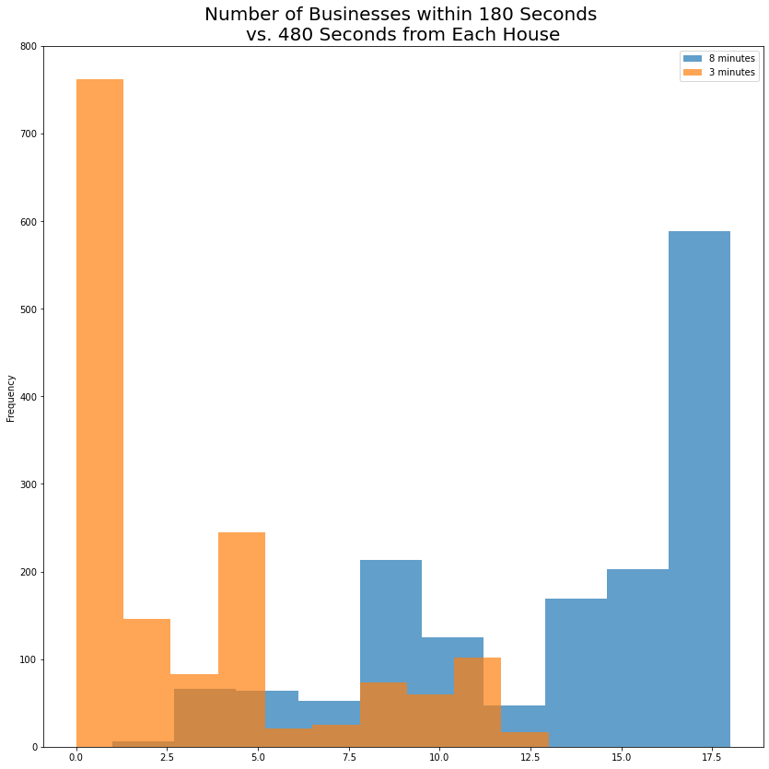
Feature Engineering Part 2

Slide 11
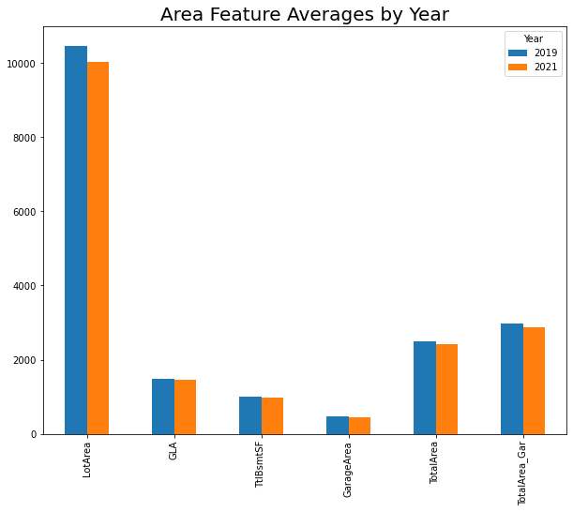
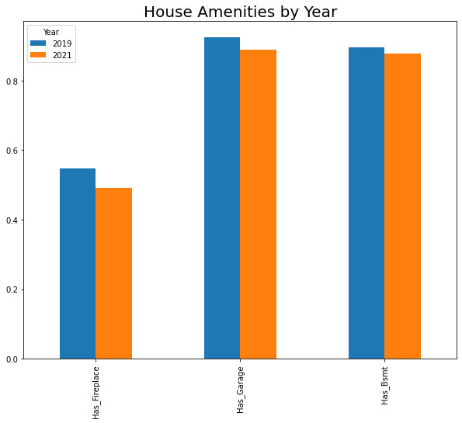
Feature Engineering Part 3

Slide 12
Feature Selection Section
Methods used for feature selection (Lasso, VIF, SFS)
Due to multicollinearity issues, VIF and Lasso were unnecessary
Chose to use ensemble techniques that can handle multicollinearity
Thus SFS was used as a greedy process, both fwd and bwd, which resulted in 37 features selected for the final model
Describe the important features in some way using a diagram or list of correlation/importances

Slide 13
Compare 2019 to 2021
Feature | 2019 | 2021
Neighborhood | Sawyer West | North Ridge
 |  | Old Town
Building Type | Townhouse End Unit
Exterior Materials |  | Wood Shingles
Heating |  | Gravity
Central Air | Yes | No
Cars |  | 4
Month Sold |  | 1
 |  | 3
 |  | 4
 |  | 6
 |  | 7
Number of Bedrooms |  | 5
Compare means of different features across both years, including SalePrice
Assess how the market may have changed due to the Pandemic
Add visualizations (map comparisons, AB testing table, hypothesis testing table etc…)
Feature | 2019 | 2021
Closest 5 Services | 226.17 seconds | 214.03 seconds
All Services Average | 365.81 seconds | 352.44 seconds

Slide 14
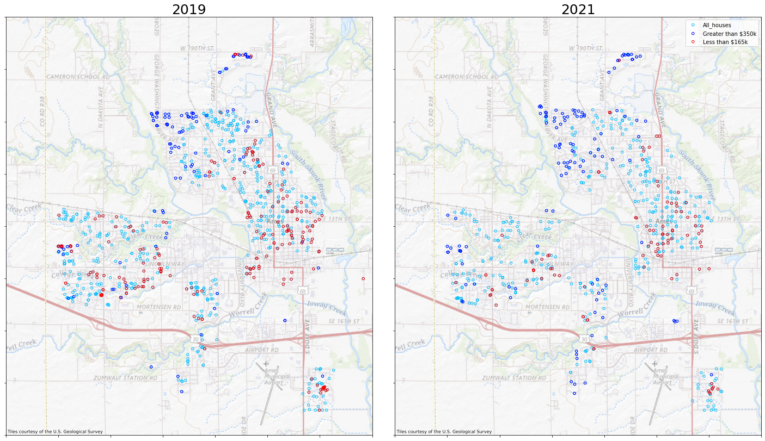
Compare 2019 to 2021 Slide 2

Slide 15
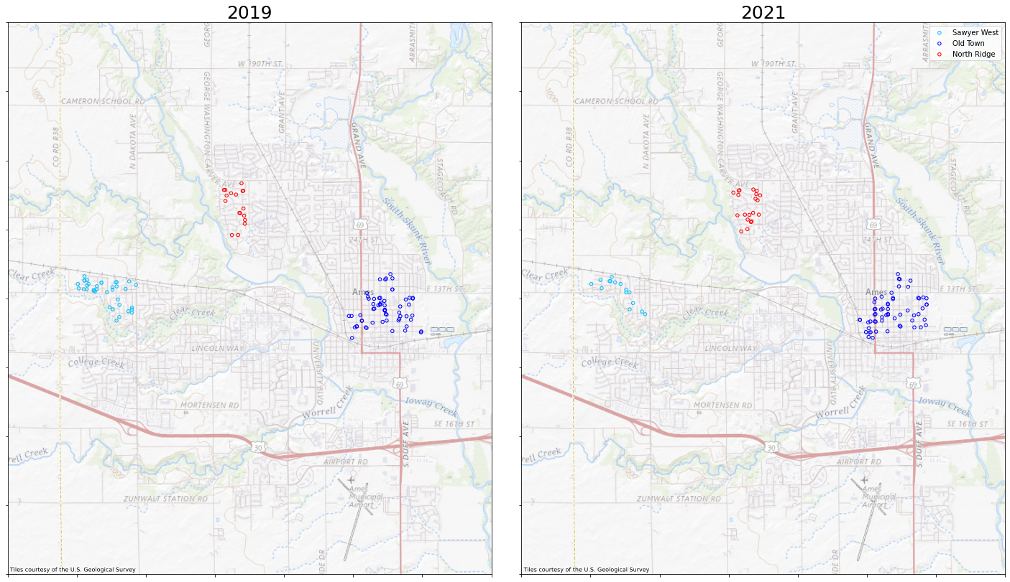
Compare 2019 to 2021 Slide 3

Slide 16
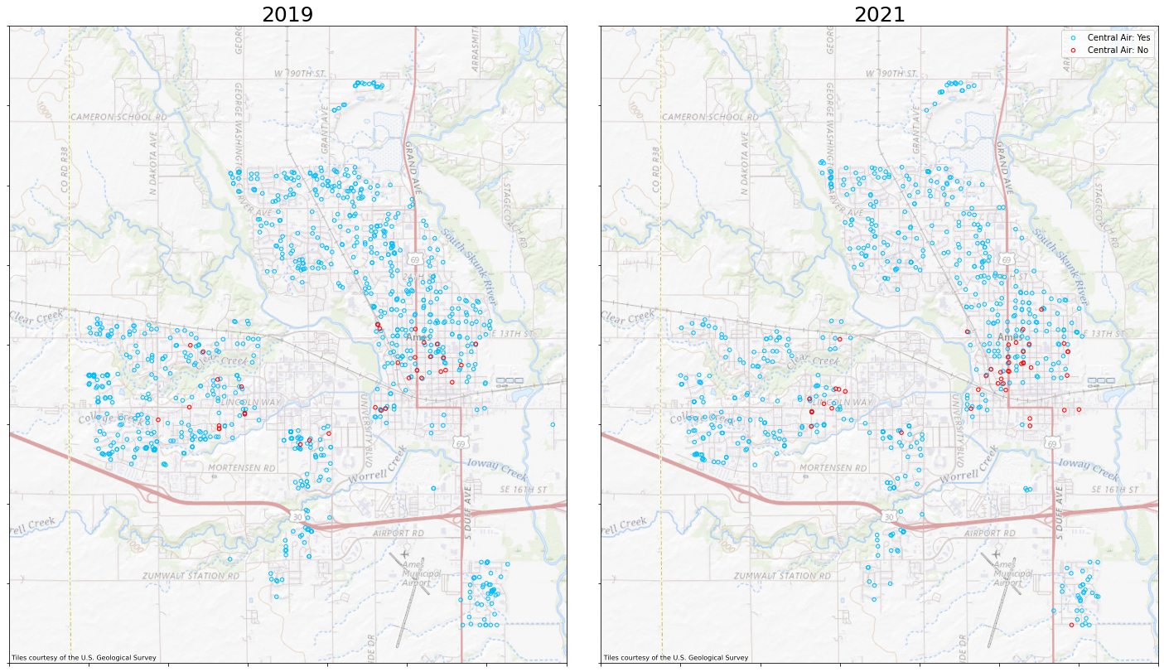
Compare 2019 to 2021 Slide 4

Slide 17
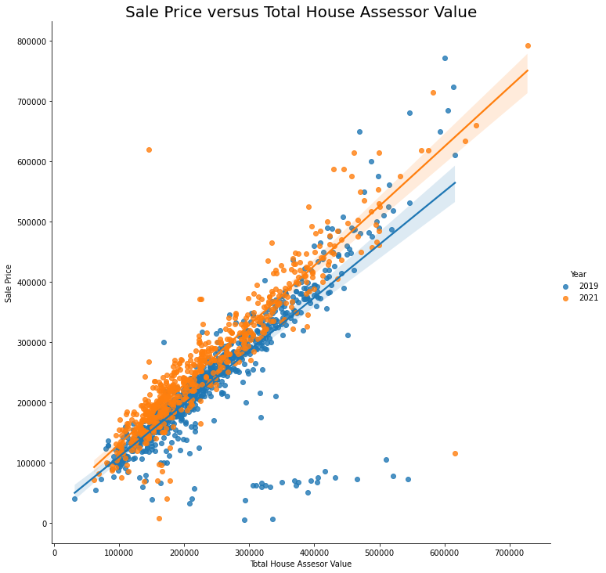
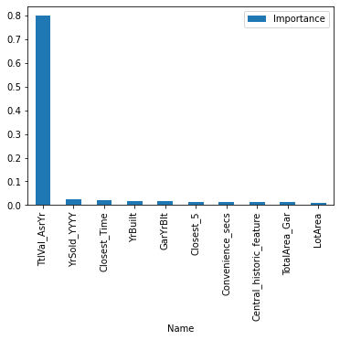
Compare 2019 to 2021 slide 5

Slide 18
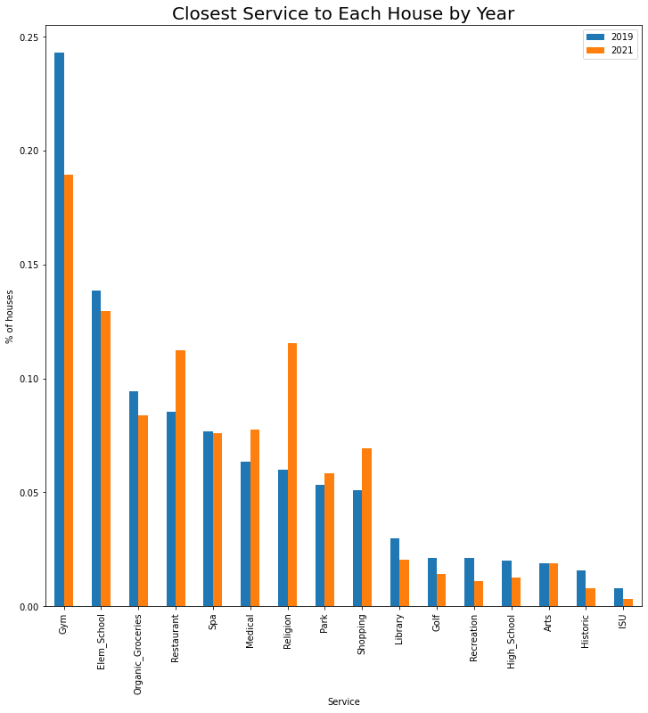

Slide 19
Final Model selection Section
Describe what models were tried (Linear, RandomForest, Support Vector Regression, GradientBoosting)
Found that GradientBoosting was the best model with R^2 of ~89%
Performed GridSearchCV to tune hyperparameters for our best model
Performed a feature selection using a greedy algorithm (Sequential Feature Selector) to narrow fields down. Ended up with 37 fields total
The final model used friedman_mse criterion and squared_error loss function

Slide 20
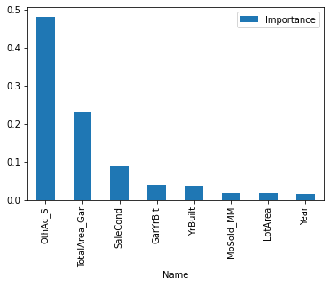
Final Model slide 2
Final model used the OthAc_S feature as opposed to TtlVal_AsrYr. TtlVal_AsrYr includes land value and home value, whereas OthAc focuses only on H ouse value.

Slide 21
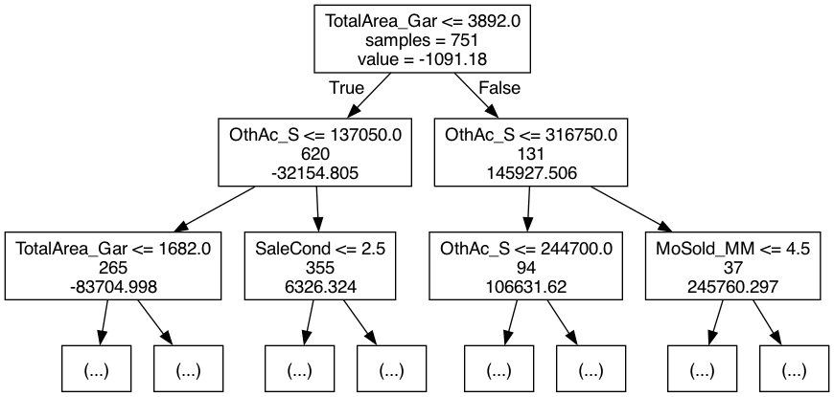
Final Model Slide 3

Slide 22
Sample House Sale
Sale No. 22472 | Built: 1970 | Changes | SalePrice | Percent Increase
 |  | None | $101,000 | 0.00%
 |  | Add Fireplace | $124,945 | 23.71%
 |  | Add Garage | $113,701 | 12.58%
 |  | Closest to Org Grocery | $115,799 | 14.65%
 |  | Closest to Spa | $131,088 | 29.79%
 |  | Year Sold 2021 | $121,251 | 20.05%
Want to predict price for 2019 and 2021
Homes Built after 1946 (post-war)
4212 is a condo, 22472 is a townhome
They only differ in price by $10k
For both, the cheapest change is to add a Garage
More expensive to find a similar home closer to a Spa vs Organic Grocery store for both
2021 housing prices are significantly larger than 2019 for both types of houses
Sale No. 4212 | Built: 1998 | Changes | SalePrice | Percent Increase
 |  | None | $90,700 | 0.00%
 |  | Add Fireplace | $126,428 | 39.39%
 |  | Add Garage | $124,172 | 36.90%
 |  | Closest to Org Grocery | $124,721 | 37.51%
 |  | Closest to Spa | $128,674 | 41.87%
 |  | Year Sold 2021 | $130,130 | 43.47%

Slide 23
Conclusion
Pandemic effects on housing market in Ames, Iowa:
Houses sold were more concentrated in the center of town and in the north and less in the west
Houses sold were closer to services in general by driving time
Houses sold were closer to religious services and further away from fitness services
Houses sold were generally older in 2021 than 2019
The market had a more even distribution throughout the year, as opposed to most sales occurring in the summer
What locations would Real Estate Agents want to advertise as good locations for people coming from out of town
For some out of towners moving from another city what are the best locations for them in terms of convenience and price of the homes (particularly for remote workers)

